Slide 1
Culture in Nursing and Healthcare
Catherine Hrycyk, MScN, RN

Slide 2
Work with the colleague sitting next to you:
Identify two culturally specific health maintenance practices from your culture.
What are the effects of illness on a family as a system?
How does culture influences the way people use healthcare services?

Slide 3
Introduction
Systems Theory – a change in one part of the system results in changes in other parts
Example: Family as a system. A change in one member affects the other members.
Nursing supports health, manages illness, and addresses complex changes and human responses to illness.

Slide 4
Illness
Illness is a personal experience
Acute illness:
Sudden onset,
Limited duration,
Can return to the state of relative health.
Chronic illness:
Gradual onset,
Requires ongoing attention and care,
Progressive course (unlikely return to pre-morbid state of health)

Slide 5
Adjusting to Illness
Follows Kubler-Ross Model:
Disbelief and denial
Irritability and anger
Attempting to gain control
Depression and grief
Acceptance and participation

Slide 6
Illness Behaviors
Cultural expectations about behaviors when ill:
Modeling – Children learn by observing adults respond to illness,
Stoicism should not be confused with strength of character.
What cultural expectations surrounding health behaviors have you experienced?

Slide 7
Influences on Illness Behaviors
Internal:
Dependence / independence
Coping ability
Resourcefulness
Resilience
Spirituality and religion
External:
Past experiences
Culture

Slide 8
Cultural Competence
Definition: It is having the attitudes, knowledge, and skills necessary for providing quality care to diverse populations (AACN, 2008).
It focuses on patient-specific needs shaped by culture.
The culturally competent nurse is more likely attuned to health disparities.
The “non-compliant” patient and the need to understand the patient’s perception of illness

Slide 9
What is Culture?
A set of beliefs, values, and assumptions about life that are widely held among a group of people and that are transmitted intergenerationally (Leininger, M. & McFarland, 2002)
Learned behavior of a society or a group (Sardar & Van Loon, 2013)
The ensemble of stories we tell ourselves about ourselves (Sardar & Van Loon, 2013)

Slide 10
Culture is ….
Socially acquired
Shared by a group
Lends identity to individuals and groups
Influences perceptions and defines the worldview
Develops over time and is resistant to change

Slide 11
Elements of Culture
Organization of production
Structure of the family and other social groups
Structure of institutions which express or govern social relationships such as child rearing, educational and religious practices, etc.
Communication tools and rituals

Slide 12
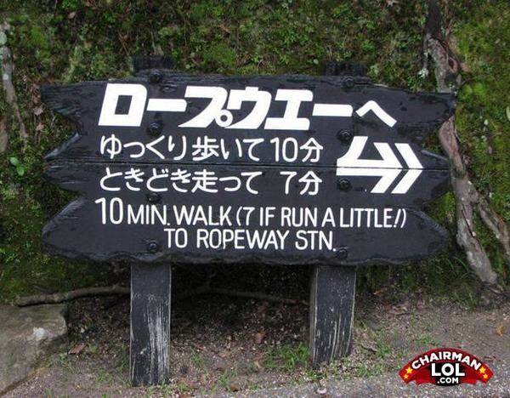

Slide 13
Ms. Fellner: Case Study on Race
Born in Recife, Brazil
Paternal grandparents:
Grandfather Danish
Grandmother African slave in Brazil
Maternal grandparents:
Grandfather Serbian
Grandmother Greek Jew
Racial classification changed when she moved to USA

Slide 14
Race
A social classification that relies on physical markers to assign group membership
Race is NOT culture
Individuals may be the same race but of different cultures
Biological aspect becoming obsolete with advancement of science and a greater focus on individual origins

Slide 15
Ethnicity
Sociocultural category
A group of qualities that marks one’s association with a particular group
Ethnic group is a collection of people who share culture and cultural identity

Slide 16
US Census Bureau Nomenclature
Widely used by health agencies and academia
What are the possible implications / problems associated with these labels?
Caucasian / White
Asian / Asian American
Latino / Hispanic
African American / Black
Native Indian / Alaska Native
Native Hawaiian / Other Pacific Islander

Slide 17
Transcultural Nursing (TN)
Cultural studies:
Center for Contemporary Cultural Studies, University of Birmingham, UK – 1964
Theories of transcultural nursing predate establishment of cultural studies as a distinct discipline - GO NURSES!!!!!
Leininger’s Sunrise Model – 1955
Why does TN matter?

Slide 18
Cultural Humility / Competence
A core competency for all registered nurses
Requires lifelong learning
Acquired through three stages:
Culturally incompetent
Culturally sensitive
Culturally competent
Each stage has three dimensions:
Cognitive (thinking)
Affective (feeling)
Psychomotor (doing)

Slide 19
Culturally Incompetent
Cognitive: Oblivious
Culturally Sensitive
Cognitive: Aware
Culturally Competent
Cognitive: Knowledgeable
Psychomotor: Unskilled
Affective: Apathetic
Affective: Sympathetic
Psychomotor: Developing skills
Affective: Committed to change / learning
Psychomotor: Highly skilled

Slide 20
Developing Cultural Competence
Cultural awareness
Cultural knowledge
Cultural skill(s)
Cultural encounter(s)
Cultural desire

Slide 21
Barriers to Cultural Competence
Cultural Conflict
Prejudice and Racism
Ethnocentrism
Cultural Shock
Stereotyping
Cultural Imposition

Slide 22
Discuss the difference…
Generalization
Stereotype

